Slide 1








Performance Testing and Comparative Benchmarking for Creating a Self-Sustaining Ecosystem for data.table
Doris Afriyie Amoakohene
Toby Hocking, Anirban Chetia
October 16, 2024

Slide 2


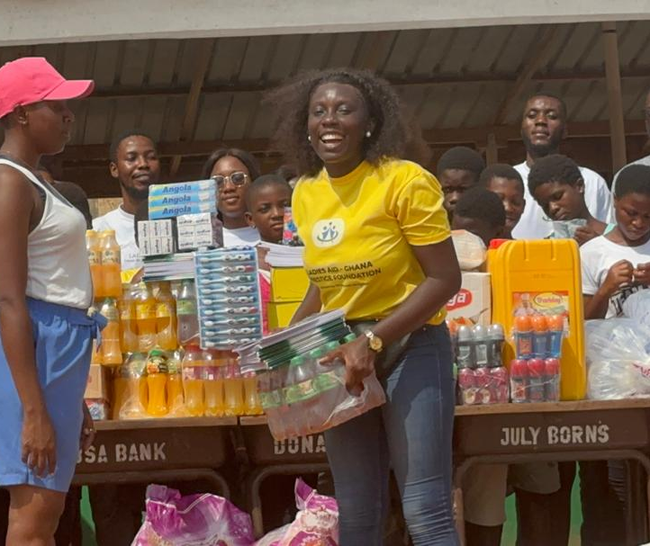

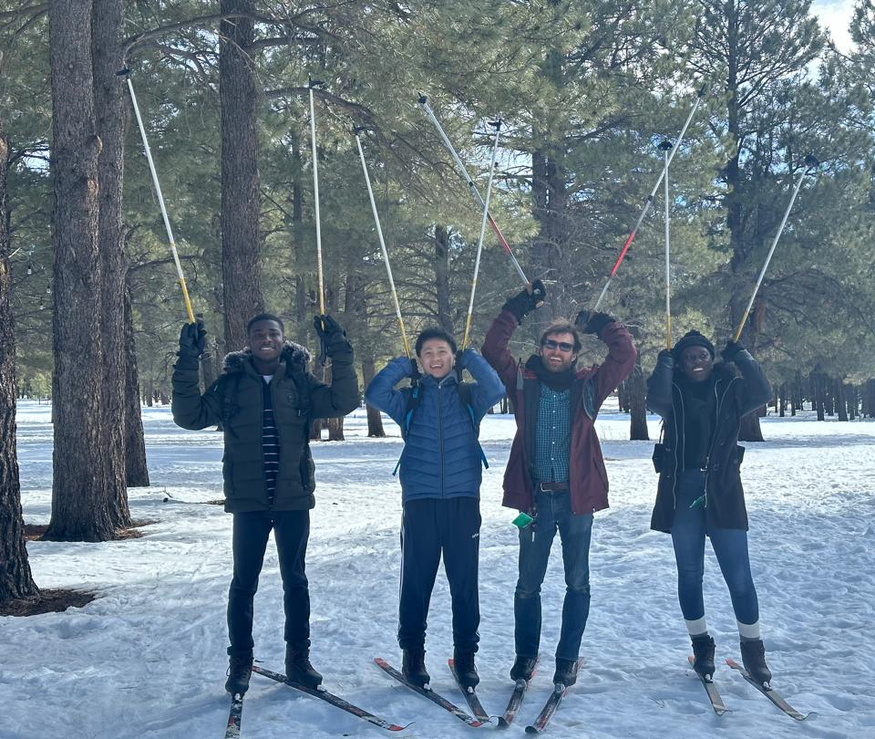
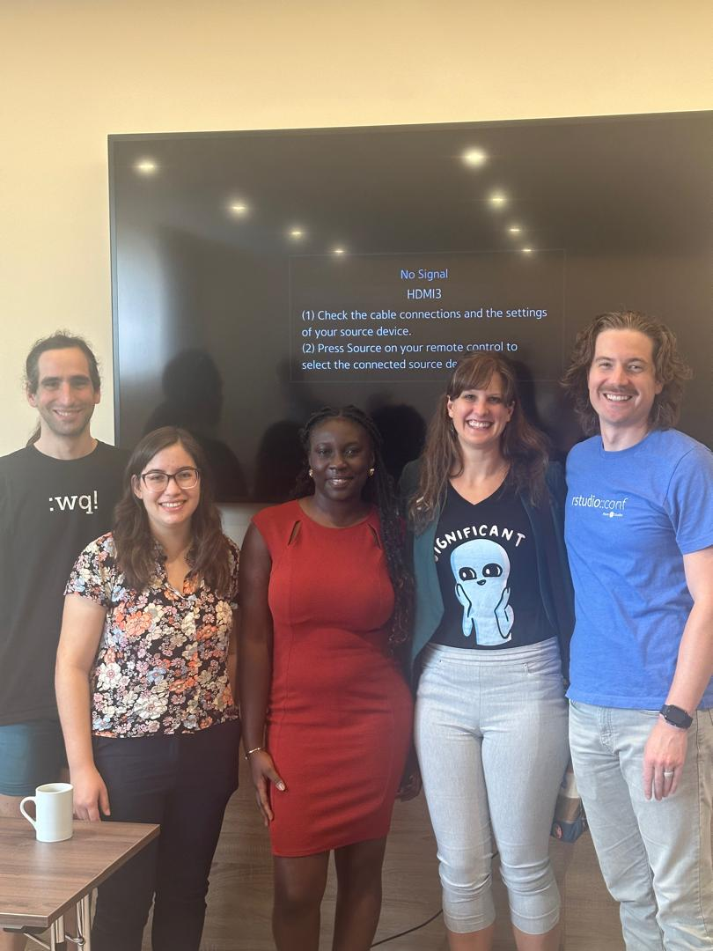

Who AM I
MSc. Informatics, NAU, SICCS
Graduate Research Assistant
Current contributor of data.table
Lively philanthropist

Slide 3





Grant
dt[ i , j , by ]
data.table?
Thanks to Toby Hocking!
As part of the NSF Project of expanding the open-source ecosystem around the data.table packages
Myself, Toby Hocking and Anirban Chetia work on Performance testing and Comparative benchmarking to enhance the efficiency of the package.
Limitation: Single data size (N) in existing benchmarking packages (airspeed velocity, conbench, touchstone, pytest-benchmarks)
Proposed: we utilize the atime package for sequential N values & asymptotic timings.
Concise syntax
Fast speed
Memory efficient
Community
Feature rich

Slide 4







Goal of the Project
The goal of this project is to create a sustainable open-source initiative for data.table, with a strong emphasis on performance testing and comparative benchmarking. By integrating these two key components, we aim to foster an ecosystem that enables the development of efficient and a high-performing data.table.
New Governance, Updated Community, New developers and New users
Self sustaining ecosystem for users/ contributors around data.table
Comparative Benchmarking
Performance Testing

Slide 5

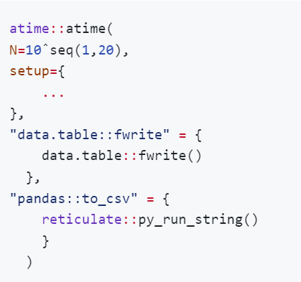


Visualizing the atime result of various Functions with data.table
atime::atime, compare time/memory/other quantities of different R codes that depend on N:
numeric vector of data sizes to vary
expression to evaluate for every data size, before timings.
named list of expressions to time.

Slide 6
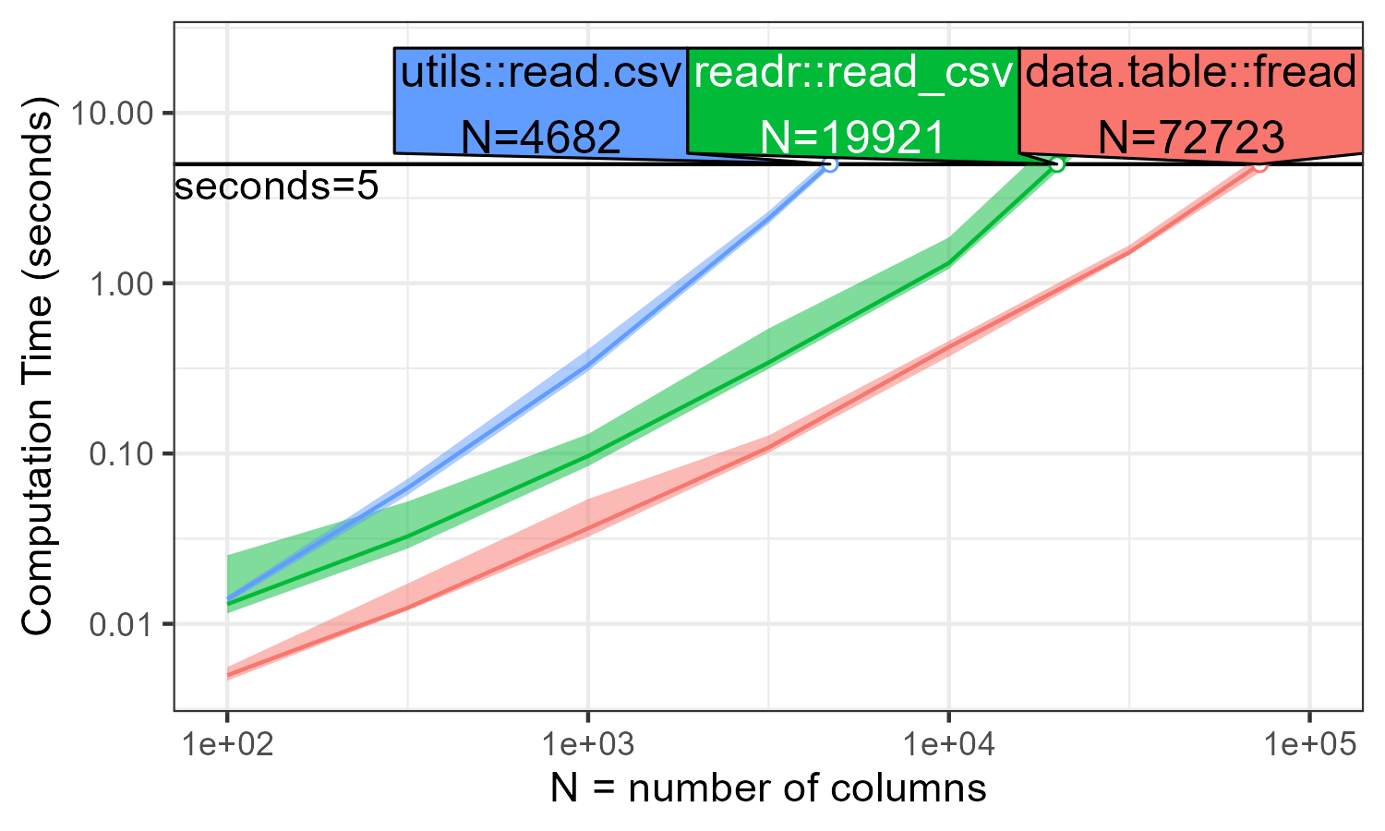



Benchmarking data.table::fread against other R packages (readr, utils) for csv reading

Slide 7

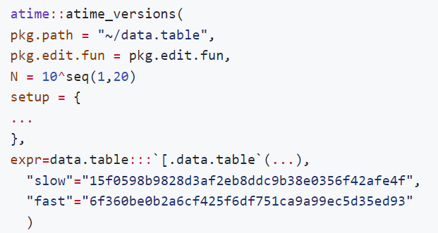




Visualizing the atime result for performance regression
atime::atime_versions: compare time/memory of different git versions of R package code
Path to git clone of repo containing R package(data.table).
expression that represents the operation being benchmarked
historical commits known to be Fast/Slow for this test case

Slide 8
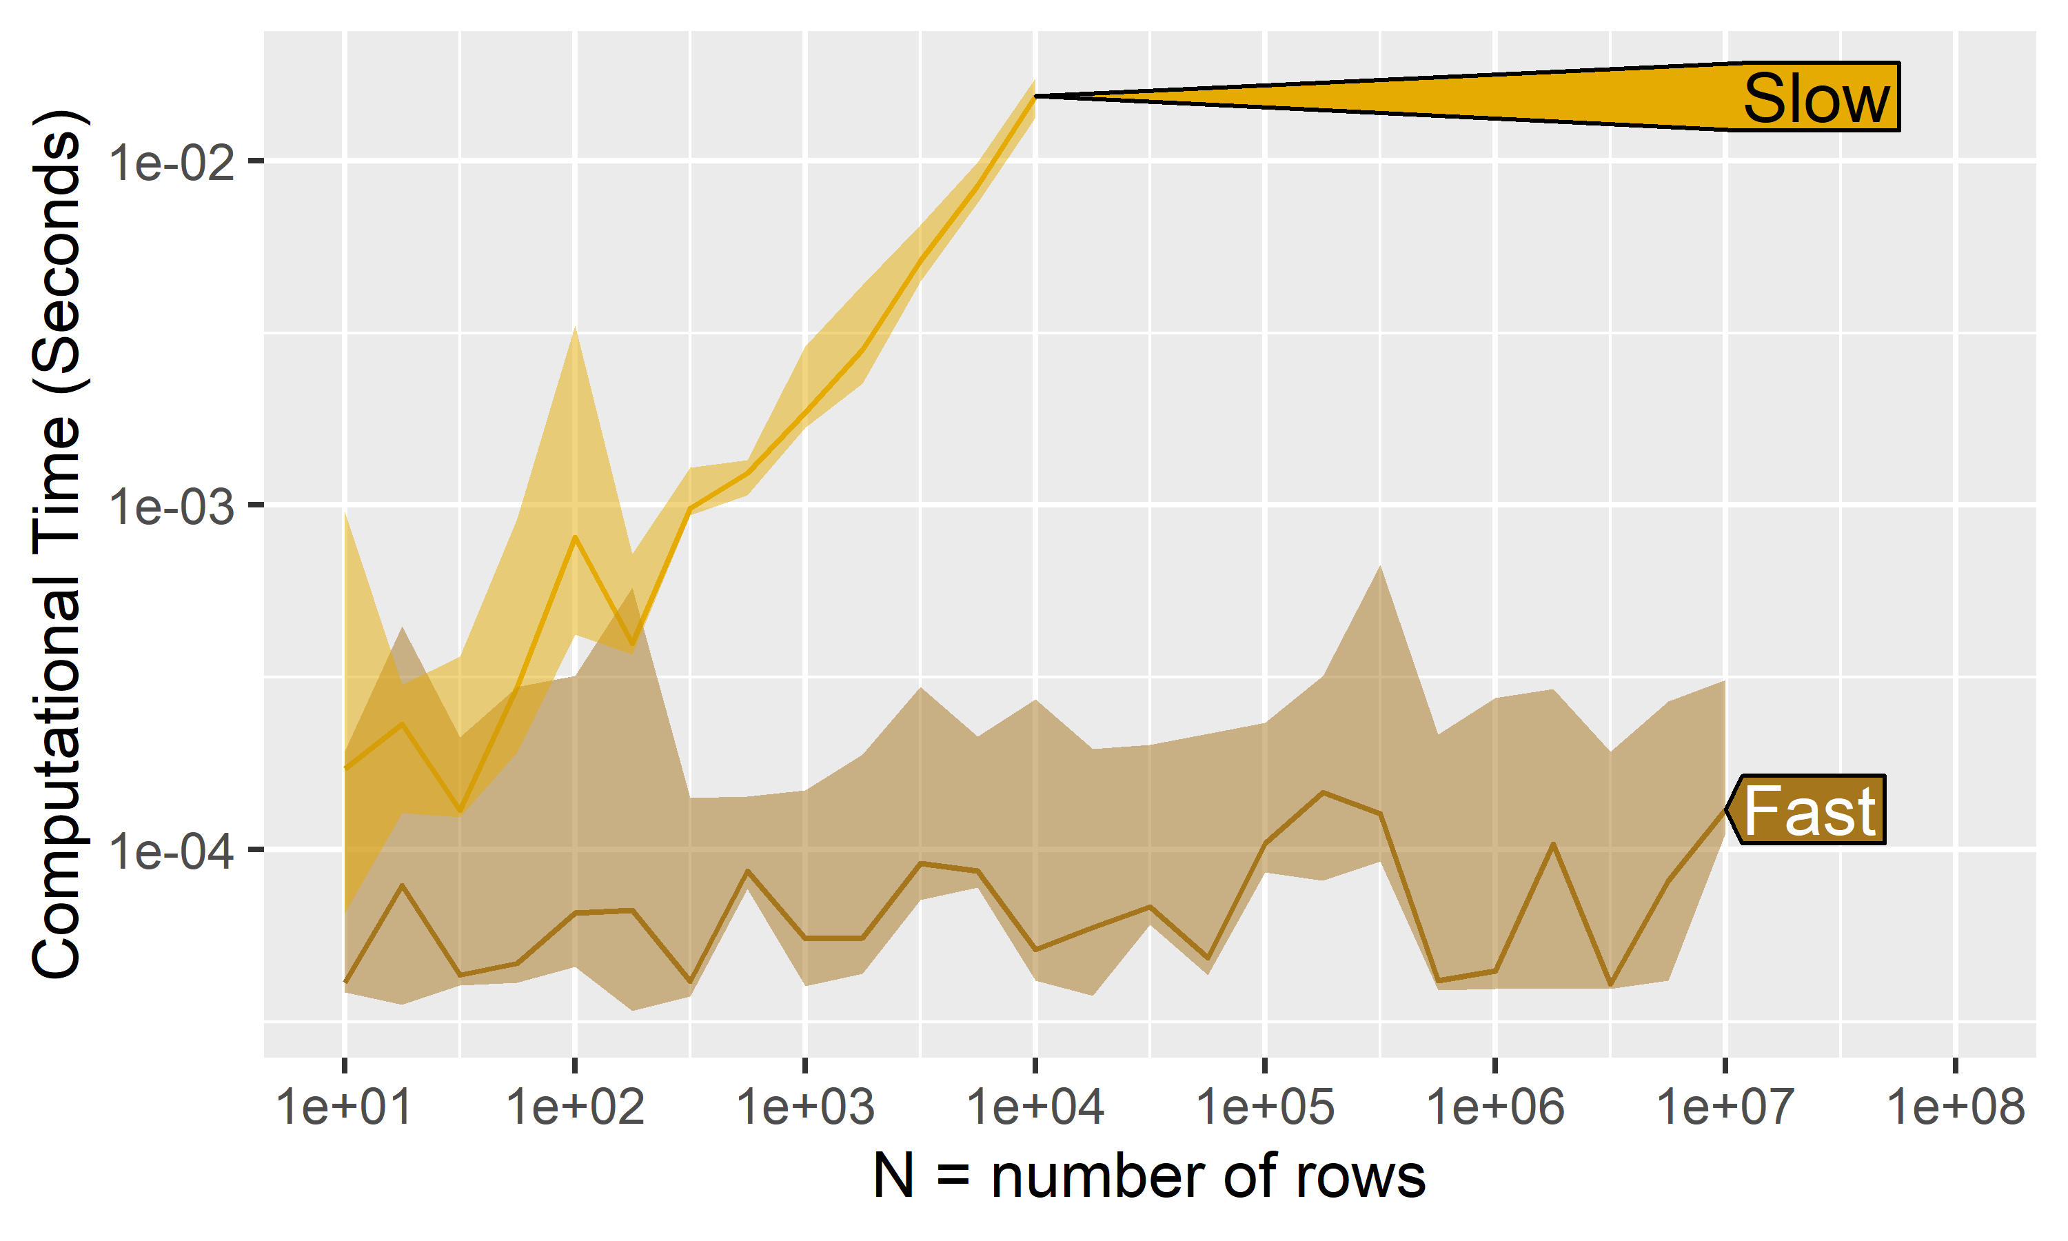
setDT extremely slow for very wide input #5427

Slide 9
Continuous Performance Testing
HEAD same as Fast, both faster than Slow/CRAN/base, so merging this PR will speed up data.table
Fast/Slow: historical commits known to be Fast/Slow for this test case
CRAN: Latest version on the CRAN platform
base: PR target
HEAD: PR source

Slide 10



CONCLUSION
01
02
03
04
Comparative Benchmarking helps us show how efficient data.table is relative to other software
Performance Testing empowers contributors to see that their changes do not harm efficiency
data.table is an efficient package for data manipulation
atime package proves to be exceptionally useful for conducting comparative benchmarking and performance testing.

Slide 11








Thank you for listening!
Thanks to Toby Hocking, Anirban Chetia, the data.table team!
daa464@nau.edu
dorisamoakohene.github.io
Doris Afriyie Amoakohene
DorisAmoakohene

